Slide 1
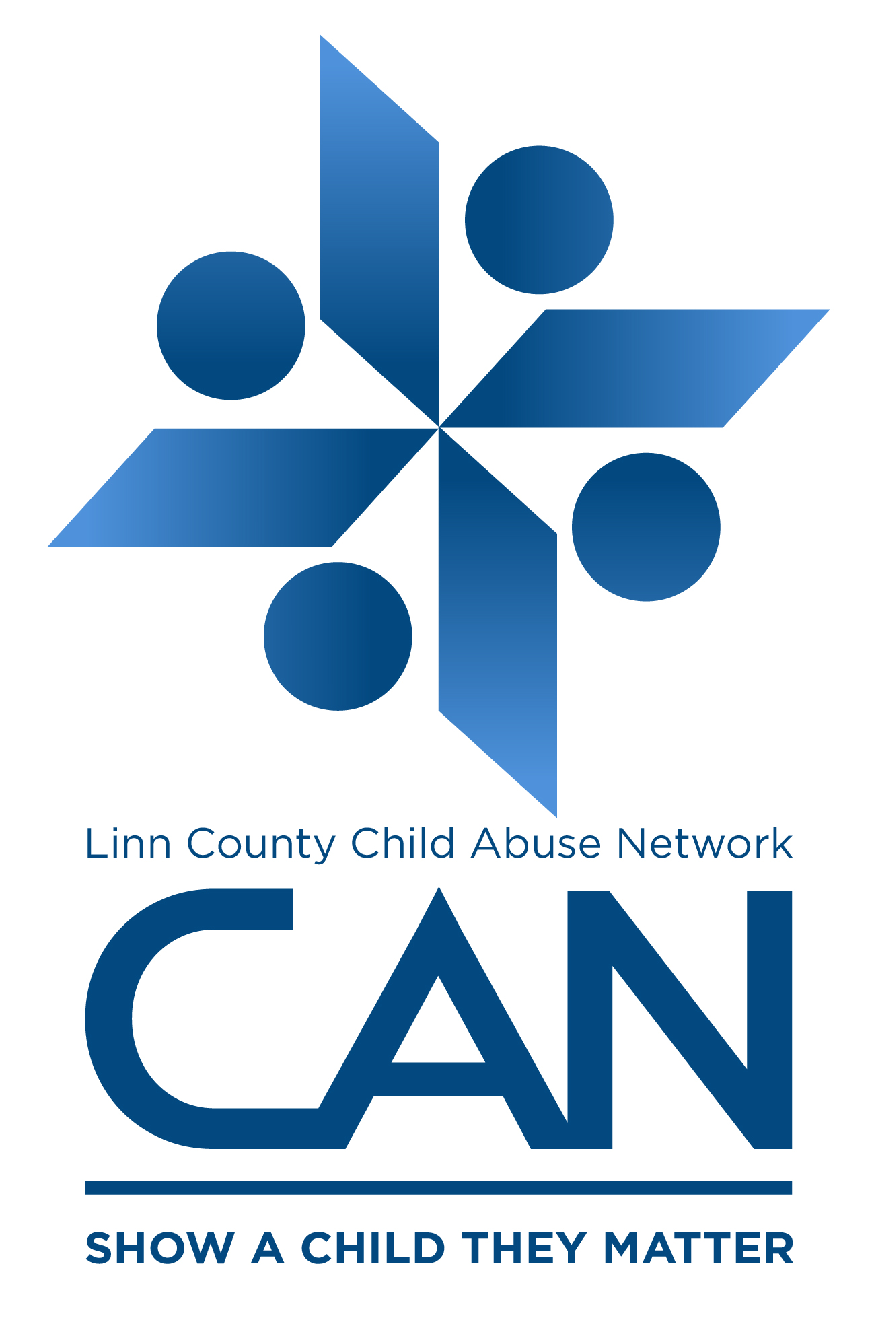
Linn County CAN (Child Abuse Network)
Together, we CAN prevent child abuse and neglect before it starts.
Together, we CAN prevent child abuse and neglect before it starts.
Convened Through:

Slide 2
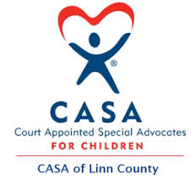
What is Linn County CAN?
Mission: Together, we CAN prevent child abuse and neglect before it starts.
Who we are: A community coalition of nonprofit agencies, educators, law enforcement and community volunteers
Our work:
Raise awareness on the epidemic of child abuse and neglect
Educate the community on ways to reduce and prevent abuse
Connect community members with trainings and youth safety policies

Slide 3
What is child abuse?
Physical Abuse: Non-accidental injury to a child, caused by a parent or caregiver who has responsibility for that child’s care.
Sexual Abuse: Any sexual act between an adult and a minor, or between two minors when one exerts power over the other. (includes both contact and non-contact sexual acts).
Drug Endangerment: A child is living/spending time where controlled substances are used, manufactured, bought/sold OR the child is exposed to a controlled substance that subjects him or her to a substantial risk to health or safety.
Emotional Abuse: A continuing pattern of hostile behavior towards a child, or the absence of positive relationships.
Neglect: Failure to provide basic needs and care for a child, to such a degree that a child’s health and safety are endangered.
Threat of Harm: Subjecting a child to a substantial risk of harm to their health or welfare.
Mental Injury: Any mental injury to a child, which shall include only observable and substantial impairment of the child’s mental or psychological ability to function caused by cruelty to the child, with due regard to the culture of the child.
Notes:
On a national level, 1 in 4 children will experience at least 1 form of abuse or neglect from 0-18.
Approximately 80% of perpetrators are parents or caregivers. Some perpetrators were once victims themselves. The stress and helplessness that can over come a parent can also contribute to abuse. Substance abuse is a factor in approximately 70% of cases.

Slide 4
Notes:
Examples of Threat of Harm: Domestic Violence, Drug Endangerment
Examples of Mental Injury: Ignoring a child/ failing to provide necessary stimulation, responsiveness or validation and nurturance; rejecting child’s value, isolating child from the family and community; terrorizing the child with continuous verbal assault; corrupting the child by encouraging destructive/antisocial behavior until the child is so impaired in soci-emotional development
Some key signs of abuse or neglect: You notice a child’s basic needs are regularly unmet,
Sexual child abuse: a child seems nervous or scared around a particular adult, You notice irregular bruising on child that does not look like play injuries, a child could behave too perfect or withdraw inward. Use of sexual behavior or language that is inappropriate for their age. Substance abuse at an early age can also be a sign.

Slide 5
Adverse Childhood Experiences (ACE’s)
“Adverse childhood experiences are the single greatest unaddressed public health threat facing our nation today.” - Dr. Robert Block, former president of the American Academy of Pediatrics
Study Began in 1998
Findings:
Two-Thirds of participants reported at least 1 Ace
The more ACEs an individual has, the more likely they are to experience high-risk behavior and long-term health problems
Notes:
Example of Aces: Parental Divorce or Separation, Domestic Violence, Abuse, Neglect, Parents struggling with substance abuse or mental illness.
Findings cross demographics,
*Conversation everyone is likely to have 1-2, things would be easier if you have 0. You may learn something that is difficult or trouble, but we are in a position to make things better for children in our area. Go to the website for ACES to learn. To learn more about aces and resources associated with that go to ____
Resources, Trauma Informed Oregon, talking to your mental health provider, CDC website

Slide 6
Impacts of trauma on the Brain
Chronic stress – Cortisol
Effects developing immune system, hormones, and way DNA is read and transcribed by the brain
On The Brain
Prefrontal Cortex a.k.a. “Thinking Center”
Anterior Cingulate Cortex (ACC) a.k.a. “Emotion Regulation Center”
Amygdala a.k.a. “Fear Center”
Notes:
Trauma can be a single event or multiple events over time (complex, prolonged trauma)
Repeated trauma over time, strengthen one’s survival neural networks making them quicker to respond.
When we feel threatened or scared, our brains move resources away from thinking and more towards survival.
3 areas of brain impacted by trauma
Prefrontal Cortex “Thinking Center”
Responsible for Rational thought, problem-solving, personality, planning, empathy and awareness of yourself/others.
Under activated in a traumatized brain
The anterior cingulate cortex (ACC) “Emotion Regulation Center”
(in part) Responsible for regulating emotions, without being totally overwhelmed by them. i.e. not over-reacting or blowing up at a situation.
Under activated in a traumatized bran
The Amygdala “Fear Center”
Outside of consciousness awareness or control
Everything you see, hear, touch, smell, and taste – Is there a threat? “Activating someone’s trauma”
Overactivated in a traumatized brain
Fight, Flight, freeze

Slide 7
Source: www.cdc.gov
Notes:
4 or more aces, 7 or more aces
Health: 12x more likely to commit suicide, 3x more
4 or more, 2.5x to develop hepatitis, 4x as likely to become depressed
Behavior: Twice as likely to abuse alcohol

Slide 8
Source: www.cdc.gov
Notes:
Home visitors: Old Mill Center, Healthy Families, Family Tree Relief Nursery
Parenting Training Programs: Family Tree Relief Nursery, LBCC Parenting Success Network
Partner Violence Prevention: CARDV
Social Support for parents: Peer Support Groups – Collaborative Problem Solving Parent Support Group, Mom Groups
Teen Pregnancy Support- Some schools have support groups for teens,
Mental Health- Linn County Mental Health
High Quality Child Care- Daycares, Pre-K, Kidco Head Start, Boys and Girls Club, YMCA
Sufficient income support for low income families- programs like affordable housing, steady jobs, government programs like SNAP and WIC

Slide 9
You CAN Heal From Trauma
People who have experienced trauma CAN heal from trauma.
What a trauma informed space looks like:
Safety
Trustworthiness and Transparency
Peer Support
Collaboration and Mutuality
Empowerment, Voice and Choice
Cultural, Historical and Gender Issues
Notes:
Trauma informed or trauma specific work is about reducing the experience of threat (emotional regulation) and restoring the capacity of the prefrontal cortex.
Positive interactions, which create safe context and connection are foundational to changing maladaptive brain patterns.

Slide 10
How to report suspected child abuse
Call Linn/Benton Child Abuse Hotline: (866)303-4643
*Or your local police non-emergency number
IF A CHILD’S LIFE IS IN IMMEDIATE DANGER
CALL 9-1-1

Slide 11
Know Your Role: Parents/Caregivers
As a parent/caregiver you CAN….
Teach children the proper names for their body parts
Learn about normal childhood development
Find your “village” a.k.a. support network
Notes:
Parents can learn normal childhood development from online resources such as 0 to 3, taking a parenting education class, or from the CDC Milestone App
Parents can find their village through parenting peer support groups, parenting classes, organizations they belong to, neighbors, family, friends, etc.

Slide 12
Know Your Role: Neighbors
As a neighbor you CAN…
Get educated on the epidemic
Become a member of someone’s “village” a.k.a. support network
Speak up

Slide 13
Know Your Role: Employers
As an employer you CAN…
Create a youth safety policy
Ensure your personnel policy supports working parents
Be trauma informed

Slide 14
For More Information:
Sign up for a training from one of our local partners:
Abuse Recognition + Mandatory Reporting
Social Media and Internet Safety
Trauma Informed Care
For More Information:
Report Suspected Child Abuse or Neglect:
(866)303-4643
Contact Us:
linncan@unitedwayoflinncounty.org
Like us on Facebook www.facebook.com/LinnCoCAN
Together we CAN prevent child abuse and neglect before it starts.

